Slide 1


Introduction to
Combining fast code writing with efficient code running
Notes:
Welcome everyone and thank you for being here.
Introduce myself
Intro to julia

Slide 2
Overview
What is ?
Introduction to syntax
Your turn to try
Community today: Who uses Julia?
< Coffee break!

Slide 3
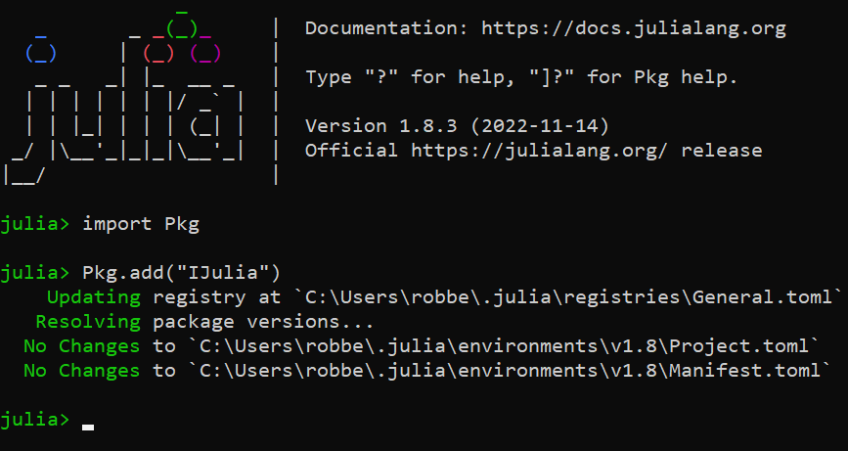
But first…
Go to: https://github.com/RobbeCeulemans/Introtojulia

Slide 4
What is ?

Slide 5




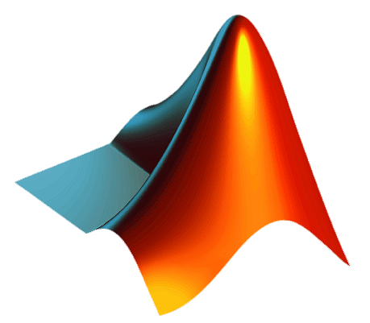
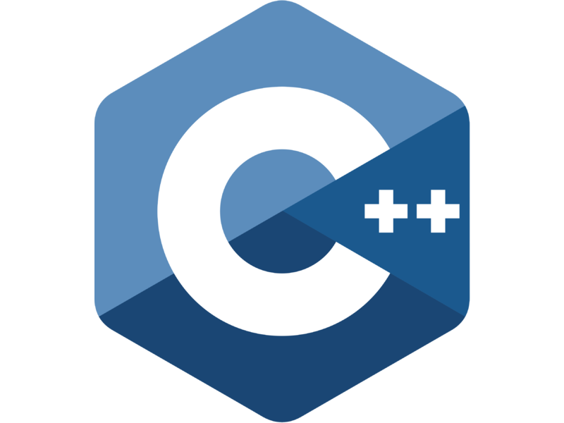




Problem: What language?
Notes:
To answer this question, we need to take a look at the current state in the field of programming languages. At the moment there is a multitude of different programming languages that one can choose from, each with there own characteristics.
Each language has their pros and cons and that is what makes choosing the “right” language for your problem to be such a point of debate.
Let’s compare!

Slide 6
Problem: What language?
Scripting languages
Compiled languages
Notes:
Often, we make a distinction between languages where your code is interpreted and executed at run time, in a step-by-step fashion, called scripting languages. On the other side are the compiling languages, that in a first step translate your code to native machine language that is then executed on the processor.

Slide 7
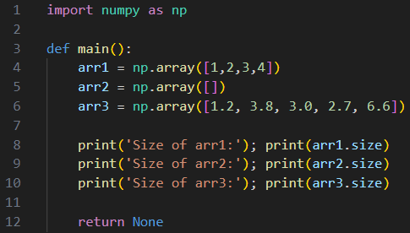
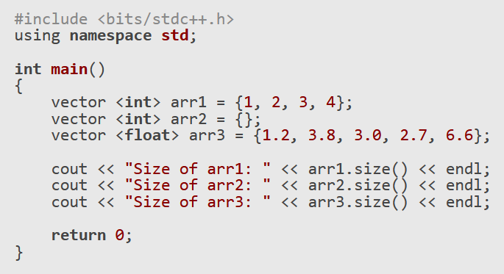
Problem: What language?
Dynamic
Static
Notes:
These two categories are sometimes also labeled as resp. Dynamic and Static languages. This refers to the way the code is typed. In Python for example the type of your variables is only evaluated at run-time. This might not seem like a big deal, but the operations that you perform, for example doing matrix multiplication they require different low-level code for different types. This means that behind this front-end there is a whole series of if-loops that type-check all the arguments in my expressions. Something that of course hurts performance.
In the case of a statically typed language, the type of each variable is known at compile time, which require explicit type annotations as shown in this C++ example. Any error in type association halts the compilation, meaning you can catch a lot of errors beforehand and don’t require dynamic type checking during runtime => increase performance. However, this also means that after every edit, the code has to be rebuilt, which also takes up time.

Slide 8
Problem: What language?
Efficient writing
Performance
Notes:
The most important consequence of this, in my opinion is that, in general, the scripting languages are easier to learn and quicker to write a script in. They are high-level languages, with a more intuitive syntax, but are often not very performant.
Compiled languages are linked to performance. Thinks of Fortran or C that are regarded as the benchmark in scientific computing. They are however a bit harder to master.
They are often more low-level, meaning that commands and functions are closer to actual processor instructions. There is less abstraction.

Slide 9
Two-Language Problem
Proof of concept
Production
Notes:
What this creates is the so-called two-language problem, where a scripting language is used, on a daily basis, to rapidly explore different aspects, to test small scale problems or to get proof of concept.
But once performance is required, a translation to a compiled language is made. => Example.

Slide 10
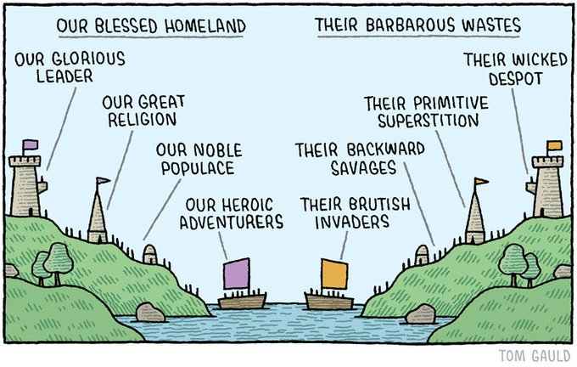
Two-Culture Problem
For the user
Development
Notes:
It’s sometimes referred to as the two-culture problem as well. Scientist, or other field experts, want something dynamic, flexible, easy-to-use, whereas developers prefer high-quality code, with only abstract design patterns.
It also creates a gap between the user and developer of a scripting language. Although Python is open source, contribution from the community is limited because development of many packages is for a large part done in C++ and Fortran.
And although this might seem like the solution, to have packages of highly optimized functions, the fact that there is always glue code in the slow language creates a bottleneck that is hard to get rid of.
What are the solutions? You could simply accept your fate and use a slow and fast language.
Speed up the slow language, but working around limitations
Or… design a new language.

Slide 11
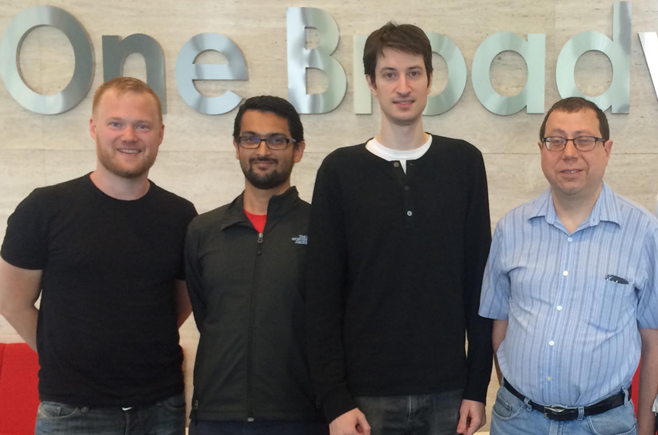
Where does fit in?
Development started at MIT in 2009
First version in 2012 == julia 0.1
From left to right: Stefan Karpinski, Viral B. Shah, Jeff Bezanson and prof. Alan Edelman
Goal: Combining best of two worlds
“We want a language that's open source, with a liberal license. We want the speed of C with the dynamism of Ruby. … We want something as usable for general programming as Python, as easy for statistics as R, as natural for string processing as Perl, as powerful for linear algebra as Matlab, …” [1]
Scripting languages
Compiling languages
Result: Flexible and easy-to-use programming language with a performance comparable to traditional languages like C or Fortran
August 2023: #20 in TIOBE index¹
[1] J. Bezanson, S Karpinski, V.B. Shah, and A. Edelman, Why we created Julia, The Julia Language Blog, https://julialang.org/blog/2012/02/why-we-created-julia/, (2012).
Notes:
As you can guess, this new language is called Julia.
What is Julia and where does it fit in? Julia is a relatively young programming language, initially developed by these four men. Development started in 2009, when where stationed at MIT, and the first version of Julia came out in 2012, Julia 0.1.
Their goals for this language where to say the least ambitious …
Is it a solution to the two-language/culture problem?
Safe to say that it is the case. I hope you will all be convinced of this answer after this workshop.
A first indication => TIOBE index
Let’s delve in a little deeper.

Slide 12
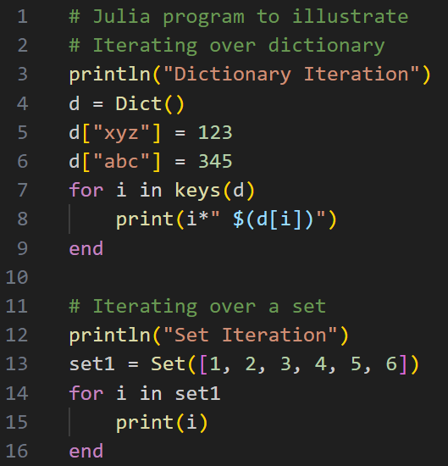
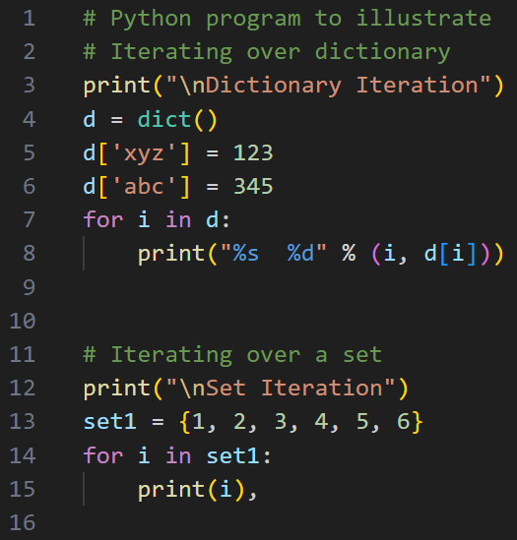

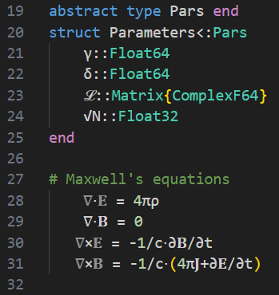
Key properties
User friendly syntax
Support for Unicode and
https://cheatsheets.quantecon.org/
Notes:
The first thing I should mention is the syntax. The founders took inspiration from many different languages. They took what they liked most from each language and combined it to create Julia. The syntax overall is very similar to Python, as shown here. I think Julia is a bit more flexible and more logical in some areas. For example the way one can work with strings is based on Perl, a highly expressive language that is much influenced by linguistic principles. This gives small differences …
Also the loops en function definitions in Python …
As a very nice extra, Julia supports unicode and Latex, if used in the right edditing environment.
I like this because …

Slide 13
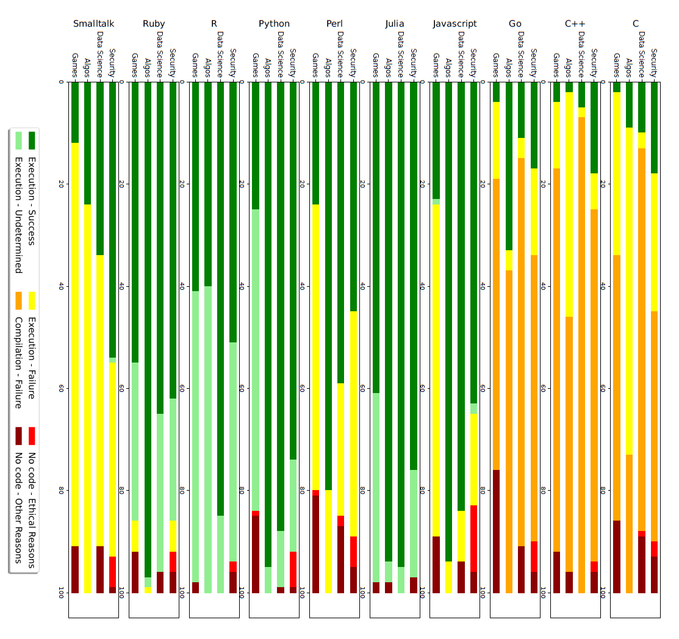
Source: A. Buscemi, arXiv:2308.04477v1 (2023)
Notes:
Large Language models

Slide 14
Key properties
C++
Python
User friendly syntax
Just-in-time (JIT) compilation
Byte code
Byte code
Native code
Execution
Execution

Slide 15
Key properties
Julia
User friendly syntax
Just-in-time (JIT) compilation
Byte code
Native code
Execution

Slide 16
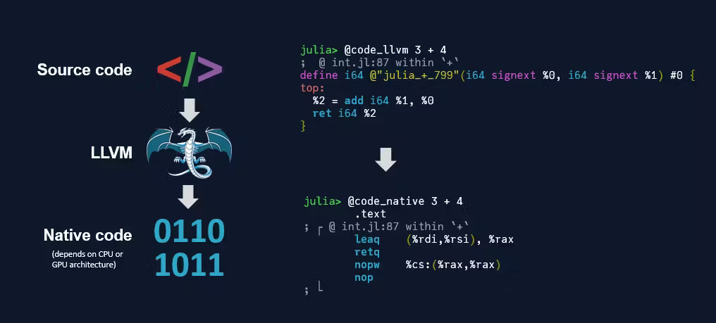
Key properties
User friendly syntax
Just-in-time (JIT) compilation
Dynamic recompilation
Source: M. Cox, The scientific coder, https://shorturl.at/gDHR8 (2023)

Slide 17
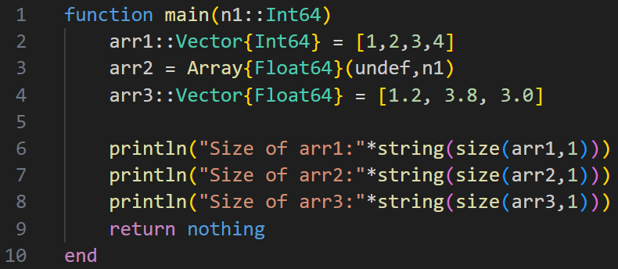
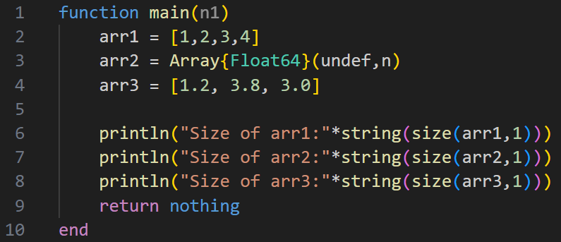
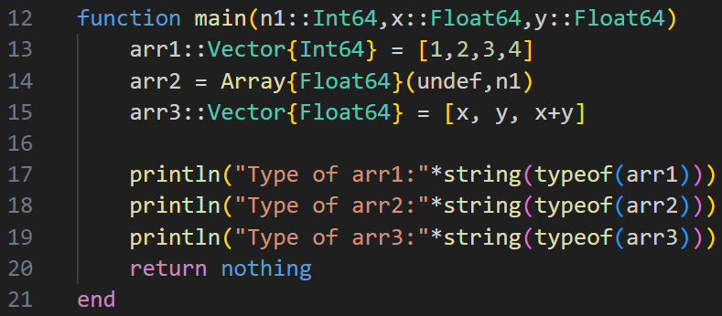
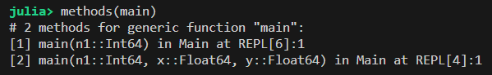
Key properties
Statically typed
User friendly syntax
Just-in-time (JIT) compilation
Dynamic recompilation
Type-oriented programming
Multiple dispatch
vs. Dynamic typing
Notes:
Julia is hybrid in the sense that it’s a dynamically typed language with many of the benefits of a static type system. It’s possible to write general untyped code. However, more expressiveness can be added be explicitly declaring types. This allows the compiler to generate efficient, specialized code for these specific types, but also improves readability and catches programmer errors.
This design of Julia’s type system can be of great assistance in generating efficient code, by using the explicit type declarations, but also allows method dispatch on the types of function arguments. This so-called multiple dispatch is a feature of programming languages where the behaviour of a function can be specified by (combinations of) the argument types. When a function is then called with a certain set of argument values the most specific method will be called (this choice is called a dispatch).

Slide 18
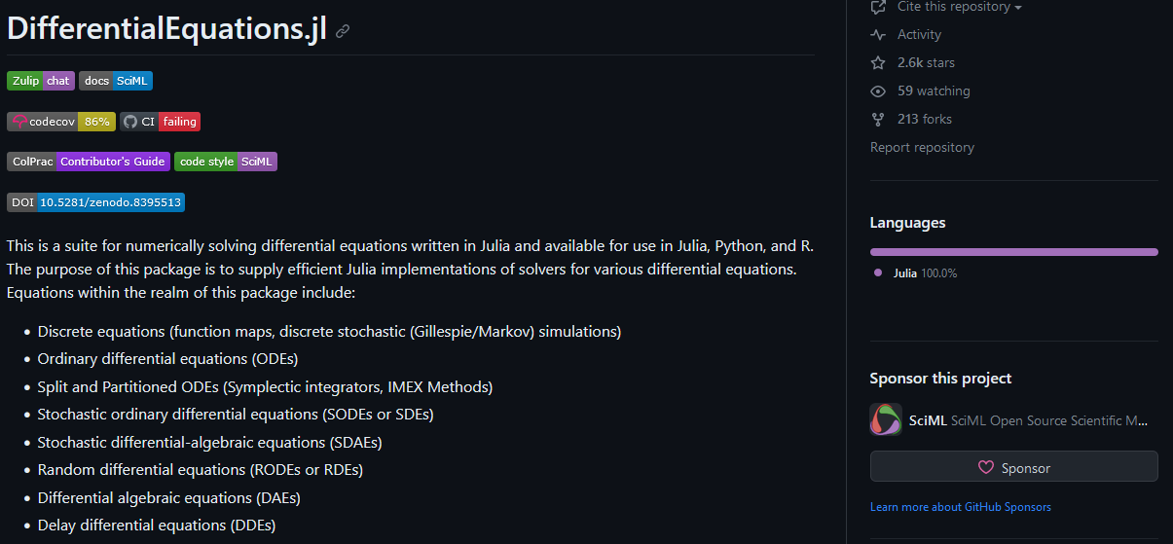
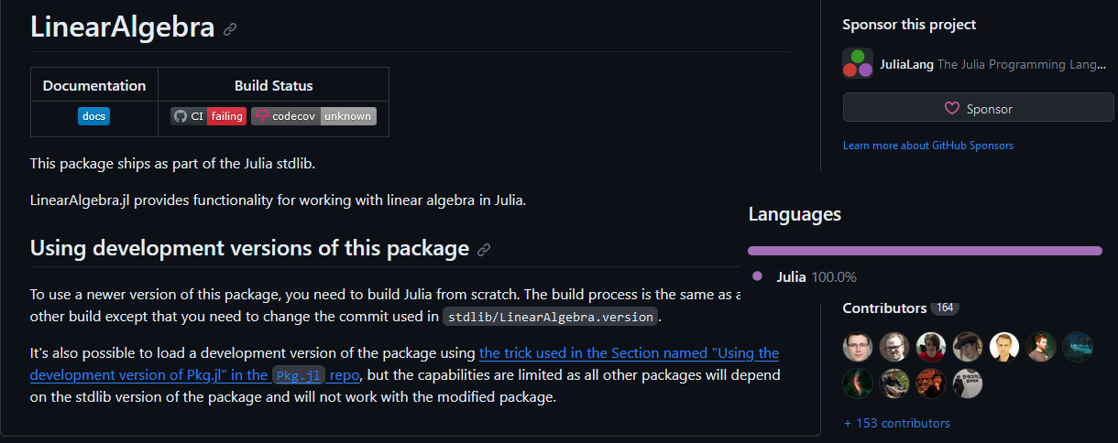
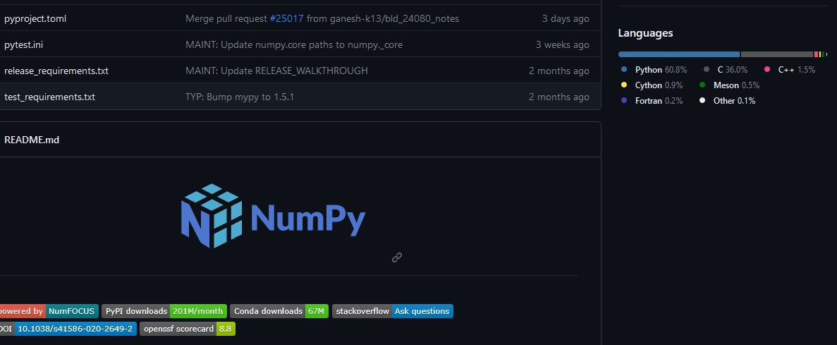
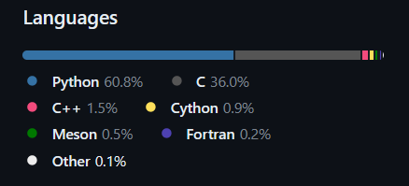
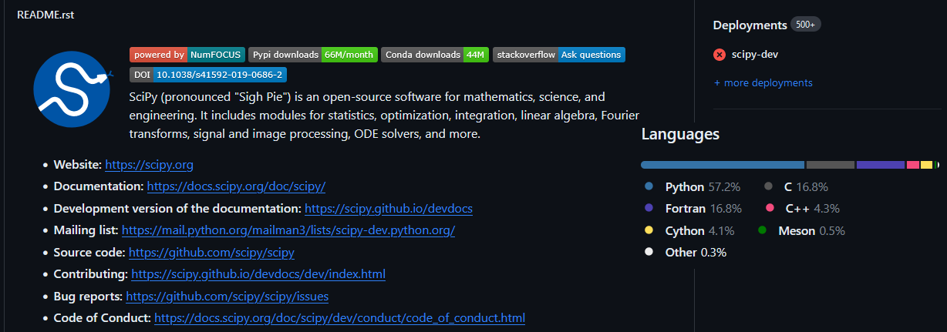

Key properties
User friendly syntax
Just-in-time (JIT) compilation
Dynamic recompilation
Type-oriented programming
Multiple dispatch
Self-hosted packages
Even base functions

Slide 19
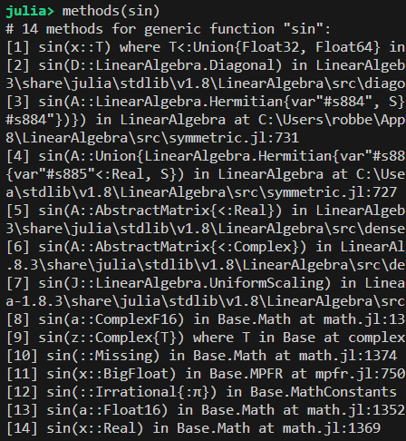
Key properties
User friendly syntax
Just-in-time (JIT) compilation
Dynamic recompilation
Type-oriented programming
Multiple dispatch
Self-hosted packages
Even base functions
Notes:
This also means that the base functions can also benefit from the smart design of Julia.

Slide 20
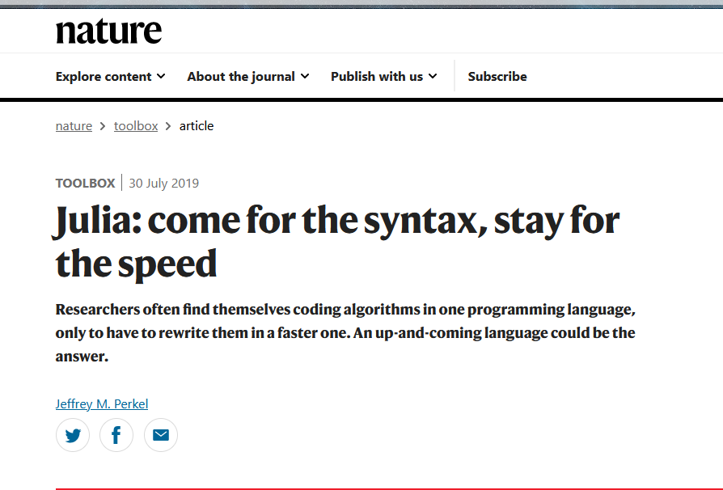
Key properties
User friendly syntax
Just-in-time (JIT) compilation
Dynamic recompilation
Type-oriented programming
Multiple dispatch
Self-hosted packages
Even base functions
Source: J.M. Perkel, Nature 572, 141-142 (2019)

Slide 21
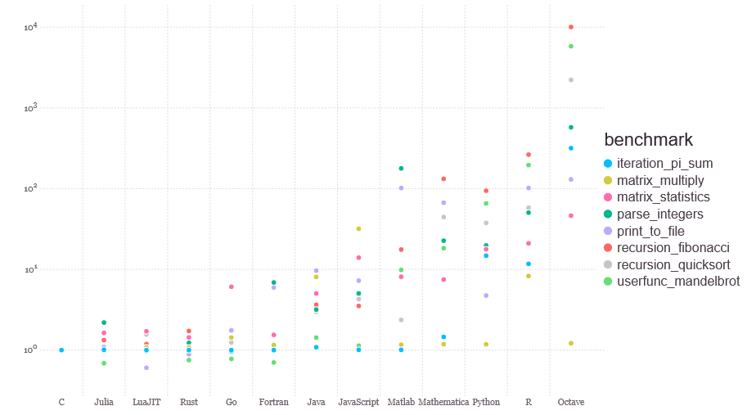
Key properties
https://julialang.org/benchmarks/

Slide 22
Introduction to syntax (in Jupyter)

Slide 23
Coffee break

Slide 24
Some example problems: Julia sets, ODEs and Game of Life

Slide 25
Community today: Who uses Julia?

Slide 26
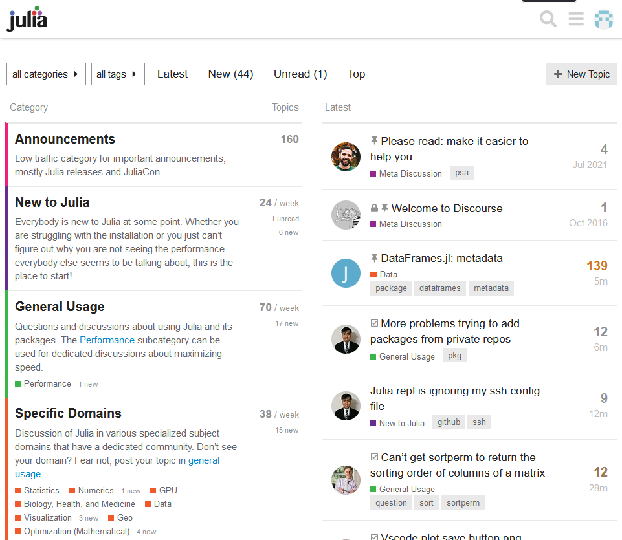


community
https://discourse.julialang.org/
Some stats¹:
50 million+ downloads
Over 10.000 packages
Annual growth of 30%
Active community
Conferences globally
¹https://juliahub.com/

Slide 27


Job opportunities?
Private sector
Academia
https://juliahub.com/

Slide 28

https://juliahub.com/case-studies/ibm/

Slide 29

https://juliahub.com/case-studies/celeste/

Slide 30

Job opportunities?
https://juliahub.com/

Slide 31
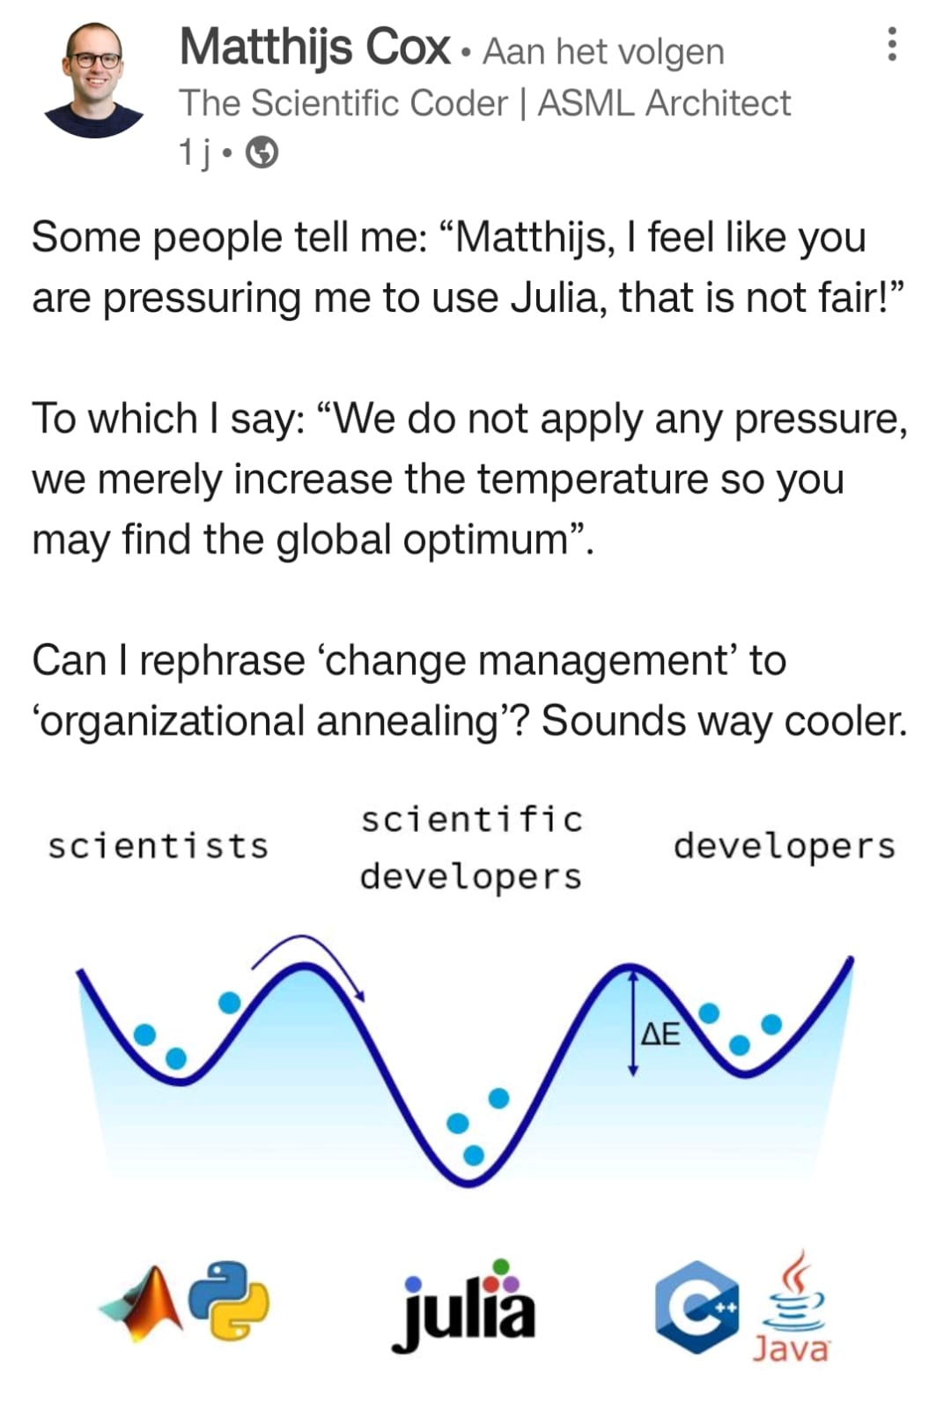
References:
[1] J. Bezanson, S Karpinski, V.B. Shah, and A. Edelman, Why we created Julia, The Julia Language Blog, https://julialang.org/blog/2012/02/why-we-created-julia/ (2012).
[2] A. Buscemi, A comparative study of code generation using ChatGPT 3.5 across 10 programming languages, arXiv:2308.04477v1 (2023).
[3] M. Cox, How to solve the two language problem?, The Scientific coder, https://scientificcoder.com/how-to-solve-the-two-language-problem (2023).
[4] J.M. Perkel, Julia: come for the syntax, stay for the speed, Nature 572, 141-142 (2019).

